Slide 1


Land Use Compatibility
CAOA Winter Conference
February 1, 2022
By Charlie McDermott, LEED AP
Aviation Planning Manager

Slide 2
Discussion Topics
Roles and Responsibilities
Common Land Uses Near Airports
Land Use Code Elements
Implementation of Land Use Codes
Examples of Airport Compatibility Zones
Colorado Airport System Plan (CASP)
Benefits of Implementing Quality Land Use
Compatibility Practices
Tips for Airport Sponsors
Land Use Planning Resources

Slide 3
Roles and Responsibilities
1
FAA
  Manages overall safety and efficiency of the national air space (NAS)
  Manages all airspace surrounding airports
  Regulates and certifies pilots and aircraft
Airports
  Fulfill their legislative mandate
  Must take action to ensure compatible land use regulations
  Educate the public on aircraft noise impacts
Notes:
Airports
--Fulfill their legislative mandate
--Operates, maintains, improves, and promotes
--Must take action to ensure compatible land use regulations
--Adopt and implement zoning, land use, and development restrictions
--Educate the public on aircraft noise impacts
--Noise disclosure, website, etc.

Slide 4
Common Land Uses Near Airports
2
Residential
Commercial
Industrial/manufacturing
Institutional
Infrastructure
Agriculture and open space
Parks and recreation

Slide 5
Land Use Code Elements
3
FAA definitions
Land use restrictions table
Nonconforming land use
Marking and lighting
Avigation easements
Outdoor lighting
Prohibited uses and activities
Allowed uses and activities
Height restrictions
Maps and figures

Slide 6
Use Restrictions Table
 | Runway Protection Zones (RPZ) | Runway Approach Surface | Airport Protection Area | Transitional Surface | Airport Traffic Pattern Area
Residential | NP | L (9) | NP | P (1) (8) | P
Schools/Churches/ Permanently Constructed Gathering Venues Open to Public | NP | NP | NP | L (4) | P
Commercial Uses/Private Gathering Venues/ Retail Venues/ Campgrounds | NP | L (4)(5) | NP | P | P
Industrial | NP | P (5) | P (4) | P | P
Institutional | NP | L (4)(5) | L (4)(5) | P | P
Roads/Parking | L (2) | P | P | P | P
Events with Spectators | NP | NP (6) | NP (6) | P | P
Airports Open to the Public (Controlled Public Access Areas on Airport Property) | NP | L (4) | L (4) | P | P
P = Permitted
L = Limited
NP = Not Permitted

Slide 7
Use Restrictions Table (cont.)
 | Runway Protection Zones (RPZ) | Runway Approach Surface | Airport Protection Area | Transitional Surface | Airport Traffic Pattern Area
Recreational Uses – Passive/Open Spaces | NP | P | P | P | P
Athletic Fields | NP | NP | NP | P | P
Mining | NP | P | NP | P | P
Agricultural | L (7) | P | P (7) | P | P
Fuel Storage Facility (Greater than 2,000 Total Gallons) | NP | NP | NP (10) | NP | P
Hazardous Material Storage | NP | NP | NP | NP | P
Wastewater Treatment Facilities | NP | NP | NP | P | P
Solar Farms (Not Private Individual Solar Uses) | NP | L (3) | NP | L (3) | P
P = Permitted
L = Limited
NP = Not Permitted

Slide 8
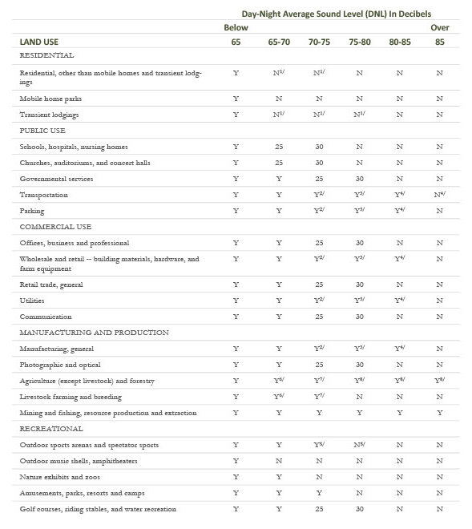
Land Use Compatibility Guidelines – 14 CFR Part 150

Slide 9
Implementation of Land Use Codes
4
Zoning
  The most commonly used form of land use control
Overlay Zones
  A secondary set of conditions that are imposed on a zoning district due to special circumstances

Slide 10
Airport Compatibility Zone Examples
5
Runway protection zone (off-airport)
Inner approach/departure area
Outer approach/departure area
Other Part 77 surfaces
Aircraft traffic pattern area
Airport protection/influence area

Slide 11
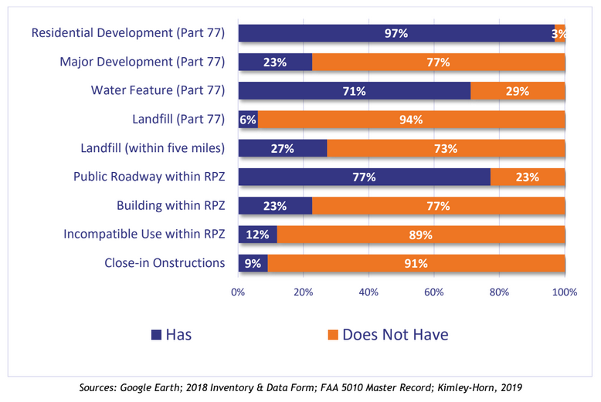
Colorado Airport System Plan (CASP)
6
Land Use Evaluation Summary

Slide 12
Benefits of Implementing Quality
Land Use Compatibility Practices
7
Improves public awareness and support for the airport
Enhances opportunities for airport development
Benefits the community living near the airport
Reduces the potential for litigation
Protects the long-term growth and prosperity of the airport
Protects the integrity of the surrounding airspace
Keeps the airport in compliance with grant assurances

Slide 13
Tips for Airport Sponsors
8
For land use compatibility, consider airspace, noise, wildlife attractants, and compatible non-aeronautical development around the airport
Be engaged and communicate with your local planners and leaders
Help educate your municipal planners and government officials on the importance of compatible development around airports
Communicate with developers about their plans to avoid negative impacts to the airspace around the airport

Slide 14
Tips for Airport Sponsors (cont.)
8
Reinforce the need for practical land use regulations, zoning ordinances, and overlay districts
Be informed of Draft FAA AC 150/5190-4B Airport Land Use Compatibility; this AC focuses on both height restrictions and broader land use compatibility, whereas the current AC focuses primarily on height restrictions
Use accurate and easy-to-read graphics

Slide 15
Airport Airspace Drawing
Harriet Alexander Field, Salida, CO

Slide 16
Land Use Planning Resources
9
FAA Advisory Circular (AC) 150/5190-4A, Model Zoning Ordinance to Limit Height of Objects Around Airports
FAA AC 150/5190-4B, Airport Land Use Compatibility Planning - DRAFT
ACRP Report 27 – Enhancing Airport Land Use Compatibility
Colorado Aviation System Plan (CASP), Appendix A. Land Use Evaluation

Slide 17


Q&A

