Slide 1

Airport Noise
Colorado Airport Operators Association
Winter Conference 2022

Slide 2

Topics
Review of Federal Regulation
Aircraft Noise Management
  Best Practices
Why People Complain

Slide 3
Major Federal Aviation Noise-Related Legislation
Statute | Aircraft Noise Related Purpose | Most Relevant FAA Regulation(s)
Aircraft Noise and Sonic Boom Act of 1968 | Authorizes FAA to prescribe standards for measurement of aircraft noise and establish regulations to abate noise | 14 CFR parts 36 and 91
National Environmental Policy Act of 1969 (NEPA) | Directs all federal executive agencies to assess all environmental effects of proposed federal agency actions | FAA Orders 1050.1F, 5050.4B
The Noise Control Act of 1972 (Noise Act) | Amends 1968 act to add consideration of public health and welfare and to add EPA to the rulemaking process for aircraft noise and sonic boom standards | None directly; EPA responsibility
Aviation Safety and Noise Abatement Act of 1979 (ASNA) | Directs FAA to establish single system to measure noise and determine exposure of people to noise, and identify land uses normally compatible with various noise levels | 14 CFR part 150
Airport and Airway Improvement Act of 1982 | Authorizes FAA funding for noise mitigation/compatibility planning and projects and establishes noise compatibility requirements for FAA-funded airport development | FAA Airport Improvement Program
Airport Noise and Capacity Act of 1990 (ANCA) | Mandates phase out of Stage 2 jet aircraft over 75,000 pounds, and established requirements regarding airport noise and access restrictions for Stage 2 and 3 aircraft | 14 CFR part 161
Section 506 of the FAA Modernization and Reform Act of 2012 | Prohibition after 12/31/2015 of operation of civil subsonic jet airplanes with maximum weights of 75,000 pounds or less that do not meet stage 3 noise standards | 14 CFR part 91
FAA Reauthorization, 2018 | Reauthorizes FAA through 2023 | None yet

Slide 4
FAA Noise Abatement Policy, November 1976
Established roles and responsibilities for:
Federal government – source emissions, air traffic control, funding, and safety oversight
State and local governments – compatible land use planning and control
Aircraft operators – noise-sensitive schedules, cockpit procedures, and fleet improvements
Air travelers and shippers – bear the costs
Current and prospective residents – seek to understand and act accordingly
Airport operators – primary responsibility for planning and implementing all noise abatement and compatible land use measures

Slide 5

Airport Noise Compatibility Planning
(14 CFR Part 150)
14 CFR Part 150 prescribes standards and systems for:
  measuring noise
  estimating cumulative noise exposure using computer modeling
  describing noise exposure
  coordinating with local land use agencies
  documenting the analytical process
  submitting the documentation to FAA
  FAA and public review processes
  FAA approval or disapproval process
The Aviation Safety and Noise Abatement Act of 1979 (“ASNA”) required FAA to:
  Establish a single, uniform, repeatable system for considering aviation noise around airport communities.
  Establish a single system for determining noise exposure from aircraft, which takes into account noise intensity, duration of exposure, frequency of operations, and time of occurrence.
  Identify land uses which are normally compatible with various exposures of individuals to noise

Slide 6
Airport Noise and Capacity Act of 1990, ANCA
Act requirement | FAA Action
Required FAA to establish phase-out of Stage 2 aircraft over 75,000 pounds | FAA promulgated Part 91 amendment (1991)
Required FAA to establish regulations regarding analysis, notice, and approval of airport noise and access restrictions | FAA implemented through FAR Part 161 (1991)
Required FAA to develop “national aviation noise policy” by July 1, 1991 | FAA published draft “Aviation Noise Abatement Policy 2000” on July 14, 2000 to replace the 1976 Federal Noise Abatement Policy

Slide 7
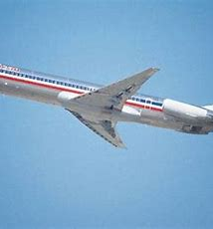
14 CFR Part 161 – in practice
Stage 2 restrictions are moot as of January 1, 2016
Restricting noisier Stage 3 aircraft types unlikely
Many potential roadblocks
Study of last resort
Two new restrictions:
  Naples Stage 2 ban
  Van Nuys Stage 2 phaseout

Slide 8
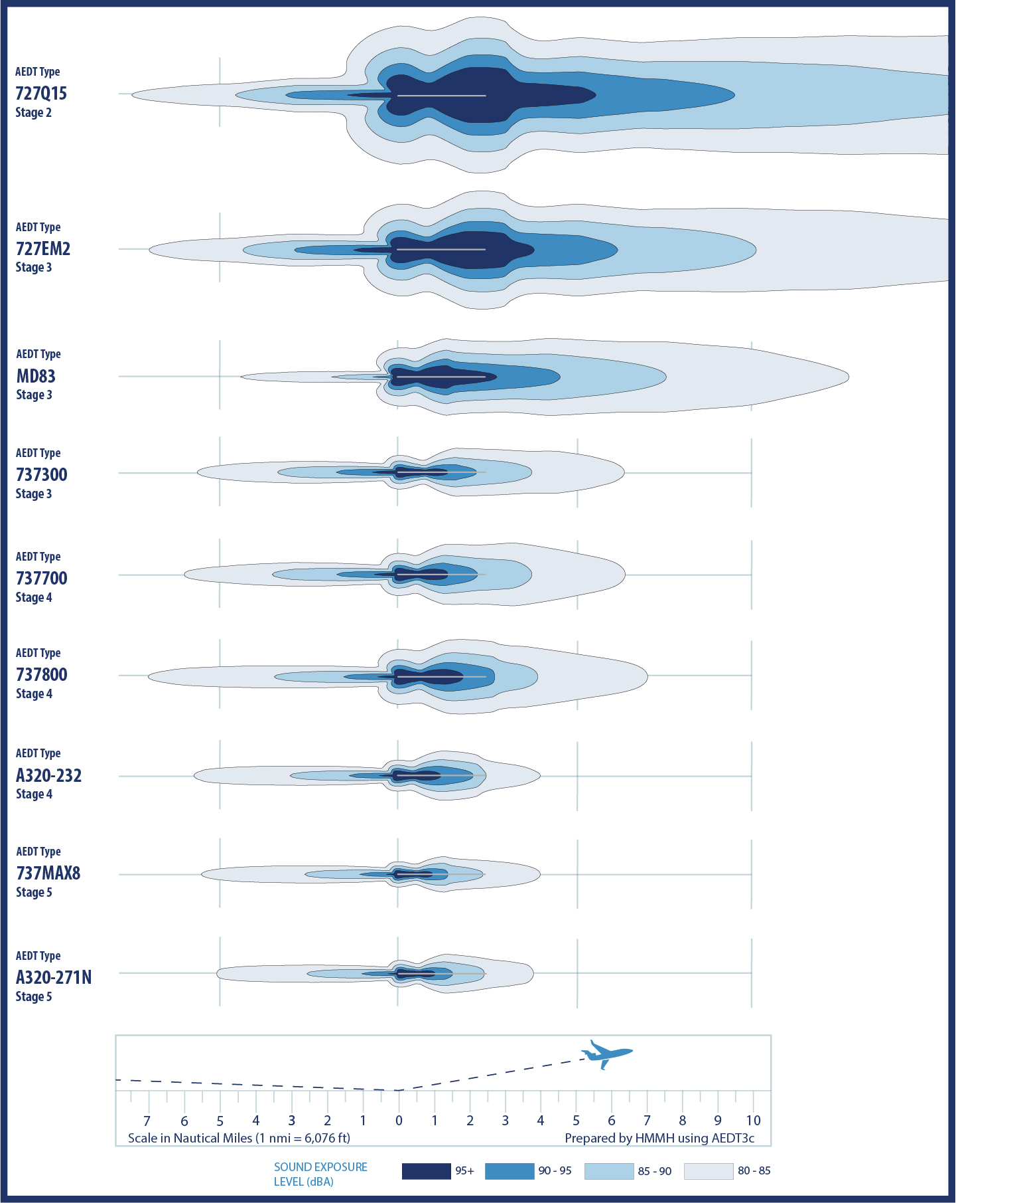
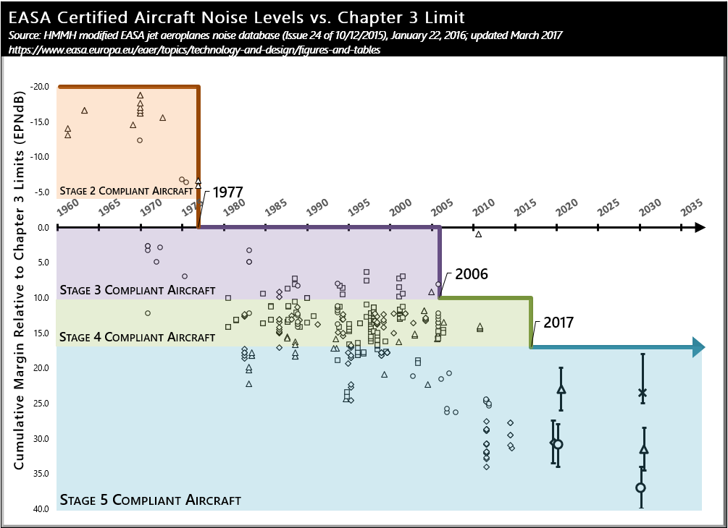
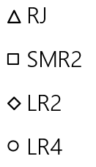
Evolution of Aircraft Noise Stages in U.S.
RJ Regional Jet
SMR2 Short/Medium Range 2-engi
LR2 Long Range 2-engine
LR4 Long Range 4-engine
Notes:
Reference the GAO report that just came out and the fact that most airlines have now retired any true Stage 3 aircraft

Slide 9
Airport Noise Management –
Issues to Consider
Community pressure alters the way you do business
Major airport development has noise implications that need to be carefully explained
Off-airport development can constrain an airport
Lawsuit threats or stipulated agreements can disrupt business
Compliance with federal (Part 150), state, and local regulations is necessary
Proactive approach can pay dividends
Getting ahead of potential issues and controlling the message makes doing business easier
9

Slide 10

Airport Noise Management Office – Pros and Cons
Pros
  Single point of contact
  Potential to reduce community pressure
  Minimize opposition to airport development plans
  Review compatibility of off-airport development
  Allows for more efficiency of other airport staff
  Provides a consistent message
Cons
  Raises community expectations
  Has potential to increase noise complaints
  Requires financial commitment of staff
  and equipment
  Is a permanent commitment to the community
  Creates another department of the
  airport to manage
Benefits
Drawbacks

Slide 11



Best Practices in Airport Noise Management
2018 study by the Metropolitan Airports Commission (MAC) and HMMH
54 airports (48 U.S., 6 Canada)
Intended to identify best practices in the industry
Data from the survey are presented throughout this session
Image Source: MAC
Notes:
In 2018, The Metropolitan Airports Commission (MAC) and HMMH conducted a noise management benchmarking study of 54 airports (48 U.S., 6 Canada) intended to identify best practices in the industry
Results provide data for airports to identify opportunities, assess progress, and recognize challenges in addressing airport noise
Data from the survey are presented throughout this module.
Benchmarking efforts such as this serve as a good baseline information set for airports to either: determine the need for creating a noise office, or modifying their existing noise program based on industry best practices.
Throughout this course, information from the benchmarking report will be provided.

Slide 12
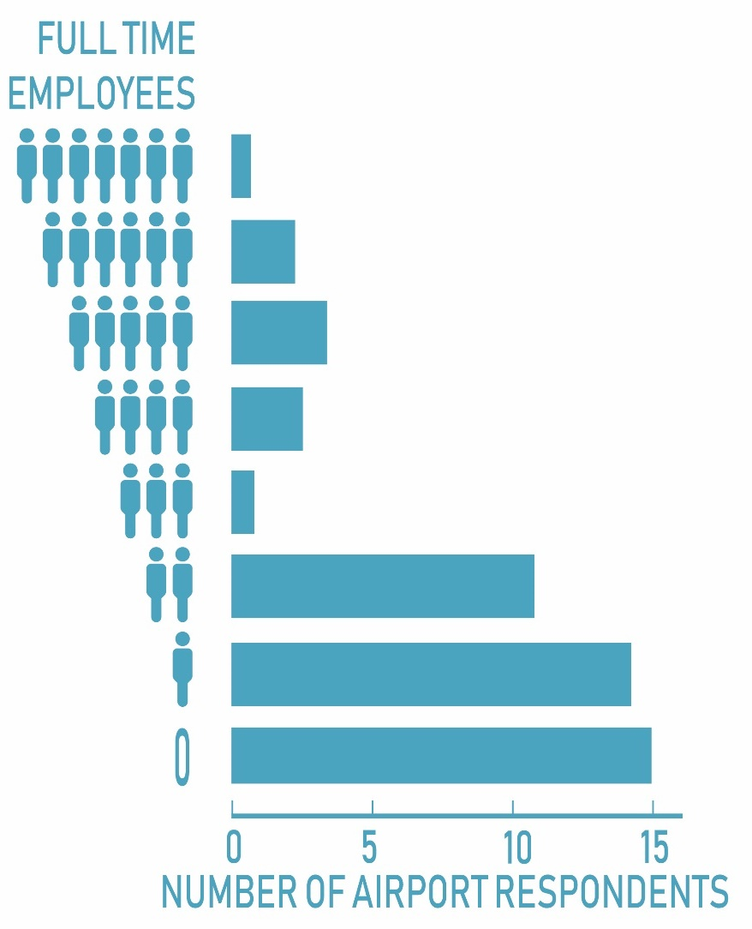


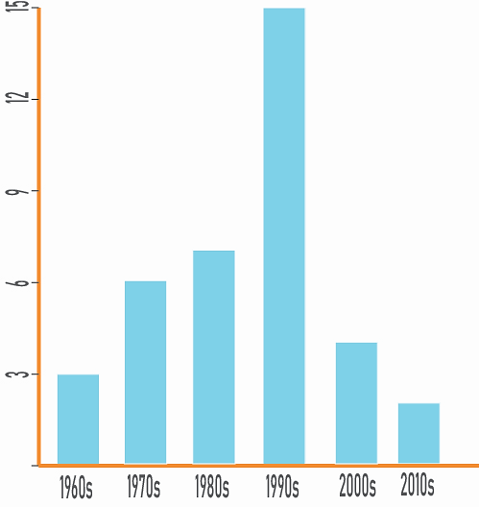
Noise Office Establishment and Staffing
Respondents with an established noise office >
Respondents that have 1 or fewer FTEs working on noise >
Decade that respondents’ noise offices were established >

Slide 13
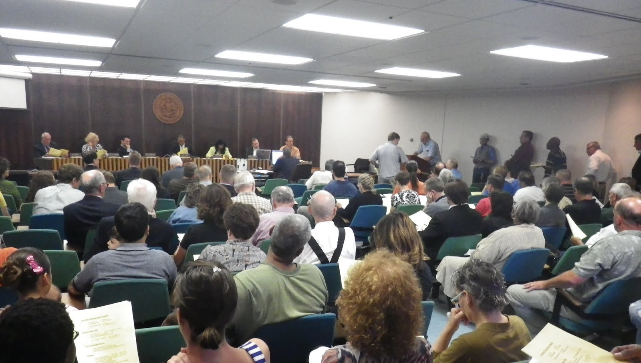
Successful Airport Noise Management Techniques –
Informing the Community (Community Engagement)
Inform the community with facts
Hearsay and misunderstandings are common; the noise office can help quell these confusions
Ways to facilitate community acceptance and understanding:
  Provide noise information by neighborhood
  Publish regular reports
  Attend regular meetings
13

Slide 14

Successful Airport Noise Management Techniques –
Airport Advisory Committee / Roundtable
Well-established framework for discussion of aircraft noise issues
  Representation from a wide spectrum of members
  Regular (monthly or quarterly) meetings
  Same message for everyone at the table
  Competing interests are given a voice
  Open to the public
Airport coordinates committee activities
Publish agendas and minutes on airport website

Slide 15
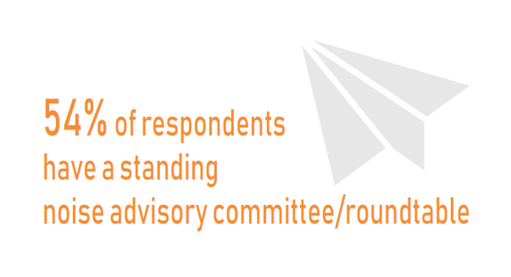
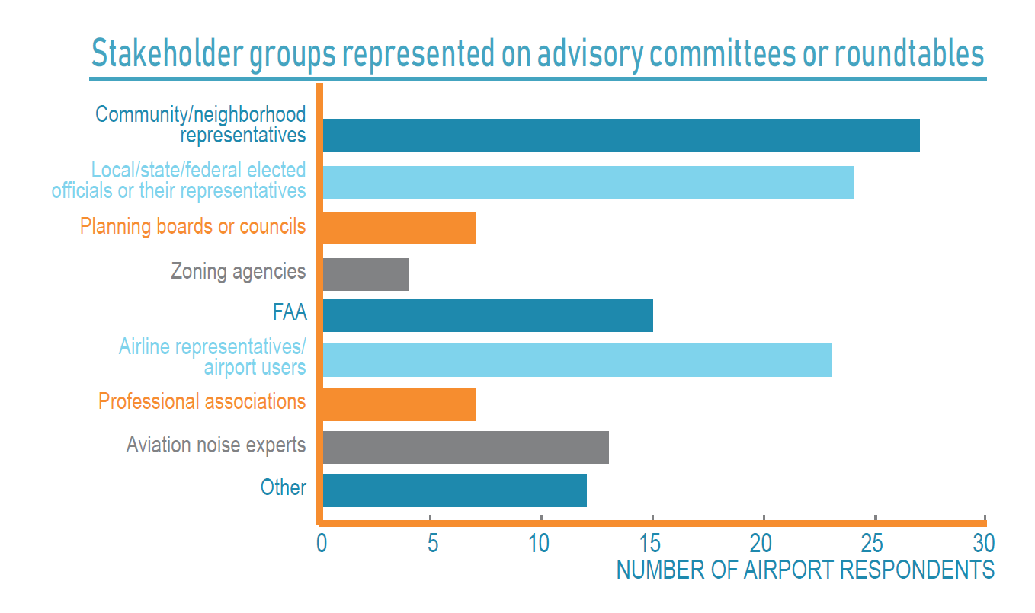

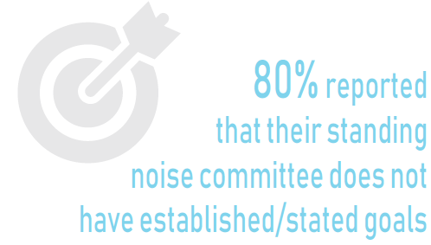
Standing Noise Committees/Roundtables

Slide 16
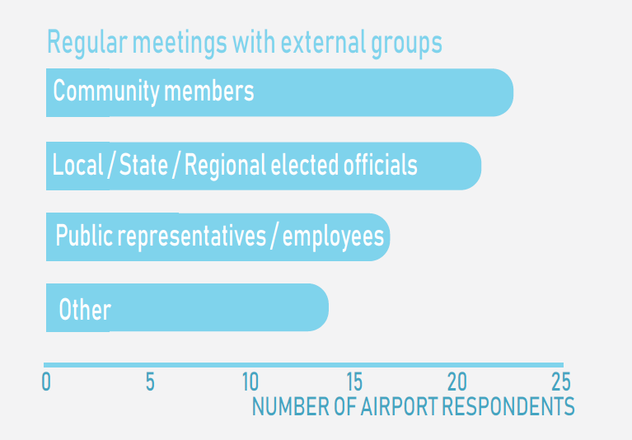
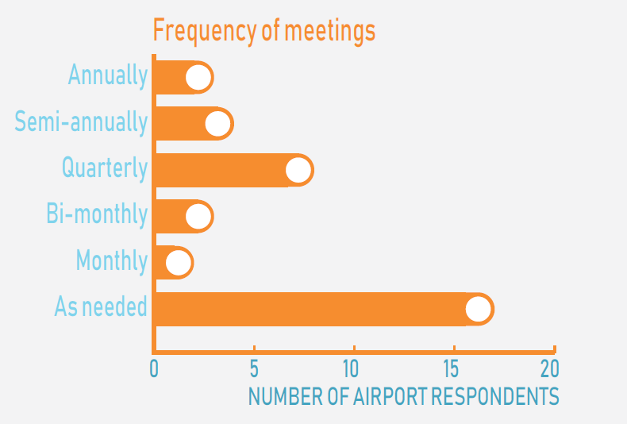
Public Meetings Beyond Formal Committees/ Roundtables

Slide 17
Successful Airport Noise Management: Build a Coalition
high
Bedfellows
High agreement/low trust share your vision but don’t always tell the whole story
Allies
High agreement/high trust share both
your vision and your intention
Fence Sitters
Won’t help you or hurt you
Simply refuse to take a stand
Usually come to their own decisions
AGREEMENT
Adversaries
Low agreement/low trust
Have resisted your outreach attempts
Opponents
Low agreement/high trust
Provide valuable relationships &
conflicting visions
low
TRUST
high
17

Slide 18

Successful Airport Noise Management Techniques – Communication Strategy
A uniform airport communication strategy ensures consistency
Standardized policies and procedures ensure a consistent approach to :
  Noise complaint responses
  Speaking with the media or elected officials
18

Slide 19

Successful Airport Noise Management Techniques – Web Portals
Maintain up-to-date web presence
Provide online noise complaint portal
Keep communities informed
Design websites simply to allow:
  Community to run their own reports
  Increased transparency for the airport
  Aircraft noise investigations – online flight tracking

Slide 20
Reasons People Complain
Looking for information
Thinking something will change
Perceiving something has changed

